Slide 1
Chapter 6: VLANs
CCNA Routing and Switching
Routing and Switching Essentials v6.0
Notes:
Cisco Networking Academy Program
Routing and Switching Essentials v6.0
Chapter 6: VLANs

Slide 2
Chapter 6 - Sections & Objectives
6.1 VLAN Segmentation
  Explain the purpose of VLANs in a switched network.
  Explain how a switch forwards frames based on VLAN configuration in a multi-switch environment.
6.2 VLAN Implementations
  Configure a switch port to be assigned to a VLAN based on requirements.
  Configure a trunk port on a LAN switch.
  Troubleshoot VLAN and trunk configurations in a switched network.
6.3 Inter-VLAN Routing Using Routers
  Describe the two options for configuring Inter-VLAN routing.
  Configure legacy Inter-VLAN Routing.
  Configure Router-on-a-Stick Inter-VLAN Routing
Notes:
2
Cisco Networking Academy Program
Routing and Switching Essentials v6.0
Chapter 6: VLANs

Slide 3
6.1 VLAN Segmentation
Notes:
6 - VLANs
6.1 – VLAN Segmentation

Slide 4
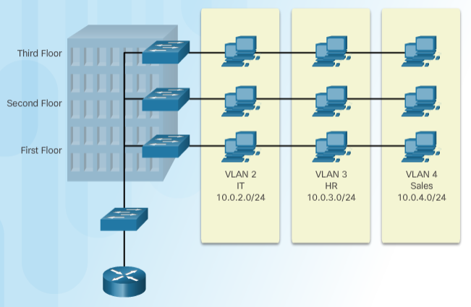
Overview of VLANs
VLAN Definitions
VLANs can segment LAN devices without regard for the physical location of the user or device.
  In the figure, IT users on the first, second, and third floors are all on the same LAN segment. The same is true for HR and Sales users.
A VLAN is a logical partition of a Layer 2 network.
  Multiple partitions can be created and multiple VLANs can co-exist.
  The partitioning of the Layer 2 network takes place inside a Layer 2 device, usually via a switch.
  Each VLAN is a broadcast domain that can span multiple physical LAN segments.
  Hosts on the same VLAN are unaware of the VLAN’s existence.
VLANs are mutually isolated and packets can only pass between VLANs via a router.
Notes:
6.1 – VLAN Segmentation
6.1.1 – Overview of VLANs
6.1.1.1 – VLAN Definitions

Slide 5
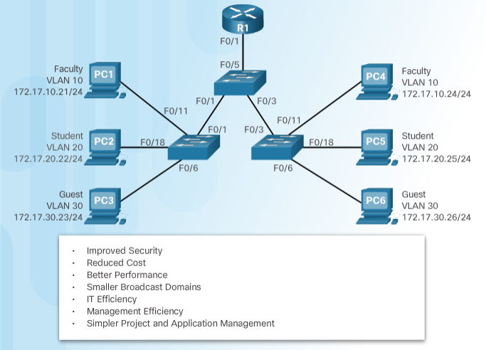
Overview of VLANs
Benefits of VLANs
Why we need VLANs
Segmentation
Simplicity of network design and deployment
Simpler troubleshooting and management.
Notes:
6.1 – VLAN Segmentation
6.1.1 – Overview of VLANs
6.1.1.2 – Benefits of VLANs

Slide 6
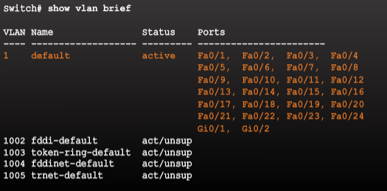
Overview of VLANs
Types of VLANs
Common types of VLANs:
  Default VLAN – Also known as VLAN 1. All switch ports are members of VLAN 1 by default.
  Data VLAN – Data VLANs are commonly created for specific groups of users or devices. They carry user generated traffic.
  Native VLAN – This is the VLAN that carries all untagged traffic. This is traffic that does not originate from a VLAN port (e.g., STP BPDU traffic exchanged between STP enabled switches). The native VLAN is VLAN 1 by default.
  Management VLAN – To create the management VLAN, the switch virtual interface (SVI) of that VLAN is assigned an IP address and a subnet mask, to carry network management traffic including SSH, SNMP, Syslog, and more.
Default VLAN Assignment
Initially, all switch ports are members of VLAN 1.
Notes:
6.1 – VLAN Segmentation
6.1.1 – Overview of VLANs
6.1.1.3 – Types of VLANs

Slide 7
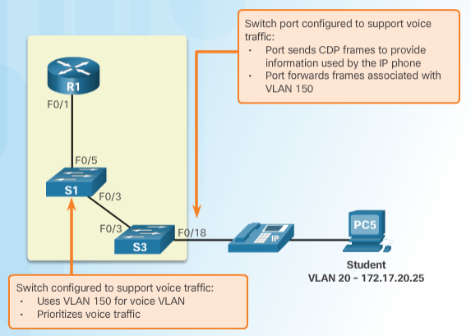
Overview of VLANs
Voice VLANs
To support time-sensitive voice traffic, Cisco switches support a voice VLAN that requires:
  Assured bandwidth
  Delay of less than 150 ms across the network to ensure voice quality
  Transmission priority over other types of network traffic
  Ability to be routed around congested areas on the network.
The voice VLAN feature enables access ports to carry user and IP voice traffic.
  In the figure, the S3 F0/18 interface has been configured to tag student traffic on VLAN 20 and voice traffic on VLAN 150.
Notes:
6.1 – VLAN Segmentation
6.1.1 – Overview of VLANs
6.1.1.4 – Voice VLANs

Slide 8
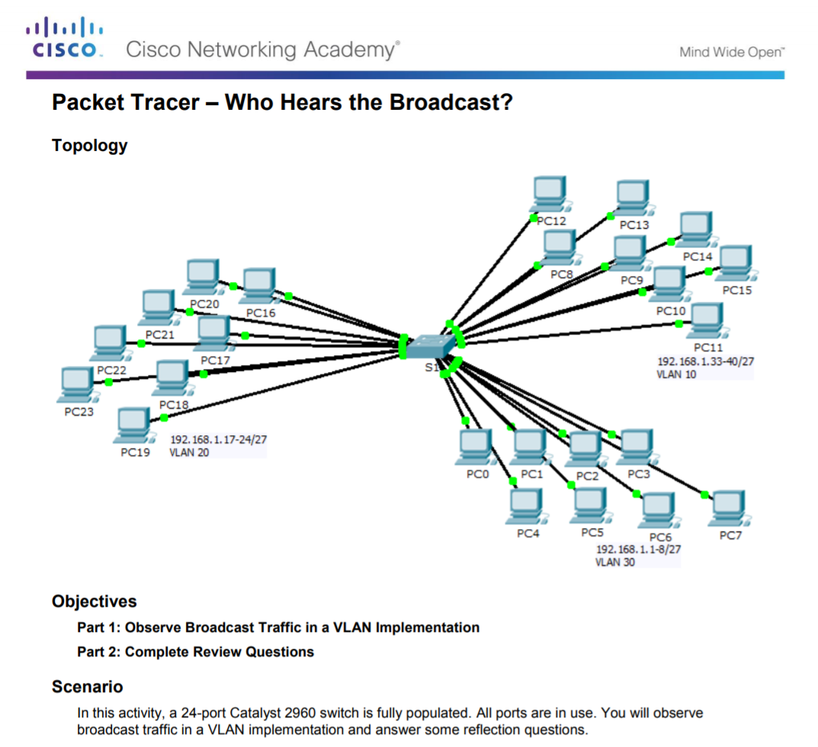
Overview of VLANs
Packet Tracer – Who Hears the Broadcast?
Notes:
6.1 – VLAN Segmentation
6.1.1 – Overview of VLANs
6.1.1.5 – Packet Tracer – Who Hears the Broadcast?

Slide 9
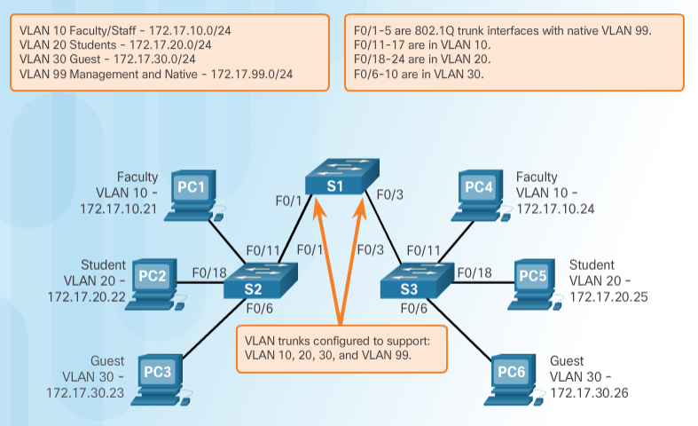
VLANs in a Multi-Switched Environment
VLAN Trunks
A VLAN trunk is a point-to-point link that carries more than one VLAN.
  Usually established between switches to support intra VLAN communication.
  A VLAN trunk or trunk ports are not associated to any VLANs.
  Provide VLAN ID for frames
Cisco IOS supports IEEE 802.1q, a popular VLAN trunk protocol.
The links between switches S1 and S2, and S1 and S3 are configured to transmit traffic coming from VLANs 10, 20, 30, and 99 across the network.
Notes:
6.1 – VLAN Segmentation
6.1.2 – VLANs in a Multi-Switched Environment
6.1.2.1 – VLAN Trunks

Slide 10
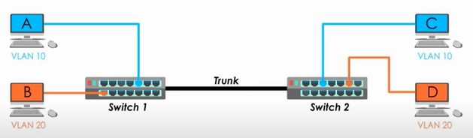
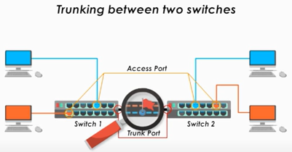
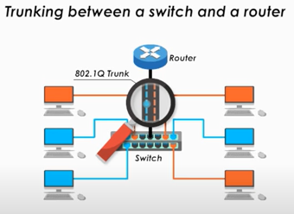
VLANs in a Multi-Switched Environment
VLAN Trunks
The process of traversing different VLAN traffic over the trunk called trunking.
Notes:
6.1 – VLAN Segmentation
6.1.2 – VLANs in a Multi-Switched Environment
6.1.2.2 - Controlling Broadcast Domains with VLANs
A single line can be a trunk not for physical cable, because of configurations of switch ports on both ends of links.

Slide 11
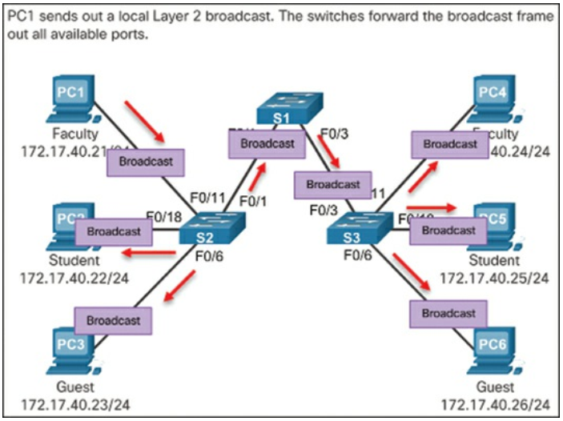
VLANs in a Multi-Switched Environment
Controlling Broadcast Domains with VLANs
Network Without VLANs
  The entire network is configured in the same subnet (172.17.40.0/24), and no VLANs are configured.
  As a result, when the faculty computer (PC1) sends out a broadcast frame, switch S2 sends that broadcast frame out all of its ports.
  Eventually the entire network receives the broadcast because the network is one broadcast domain.
Notes:
6.1 – VLAN Segmentation
6.1.2 – VLANs in a Multi-Switched Environment
6.1.2.2 - Controlling Broadcast Domains with VLANs

Slide 12
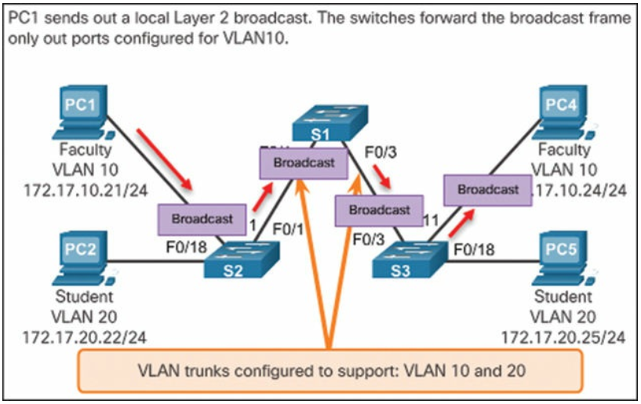
VLANs in a Multi-Switched Environment
Controlling Broadcast Domains with VLANs
Network with VLANs
  The network has been segmented using two VLANs.
  Faculty devices are assigned to VLAN 10, and student devices are assigned to VLAN 20.
  A broadcast frame is sent from the faculty computer, PC1, to switch S2.
  The switch forwards that broadcast frame only to those switch ports configured to support VLAN 10.
Notes:
6.1 – VLAN Segmentation
6.1.2 – VLANs in a Multi-Switched Environment
6.1.2.2 - Controlling Broadcast Domains with VLANs

Slide 13
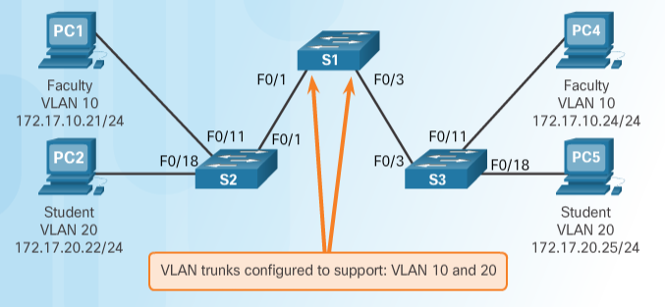
VLANs in a Multi-Switched Environment
Controlling Broadcast Domains with VLANs
If a switch port receives a broadcast frame, it forwards it out all ports except the originating port.
  Eventually the entire network receives the broadcast because the network is one broadcast domain.
VLANs can be used to limit the reach of broadcast frames because each VLAN is a broadcast domain.
  VLANs help control the reach of broadcast frames and their impact in the network.
In the figure, PC1 on VLAN 10 sends a broadcast frame.
  Trunk links between S2 - S1 and S1 - S3 propagate the broadcast to other devices in VLAN 10.
  Only devices in the same VLAN receive the broadcast therefore, PC4 would receive the broadcast.
Notes:
6.1 – VLAN Segmentation
6.1.2 – VLANs in a Multi-Switched Environment
6.1.2.2 - Controlling Broadcast Domains with VLANs

Slide 14
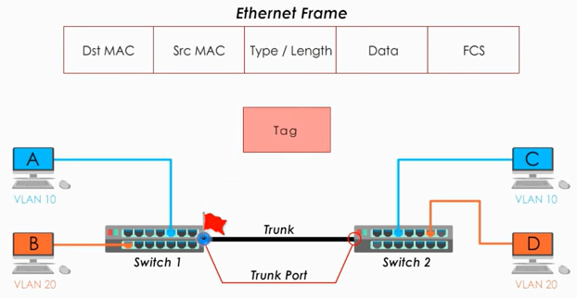
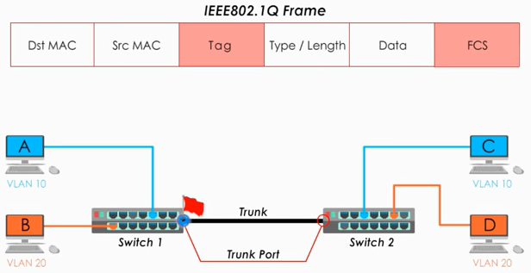
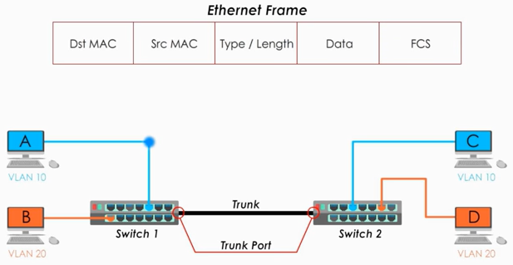
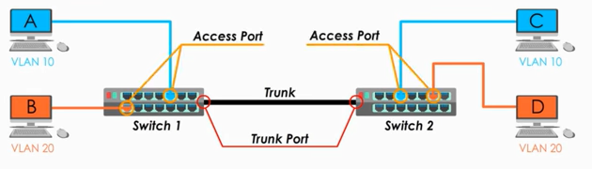
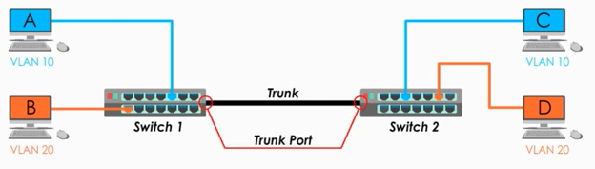
VLANs in a Multi-Switched Environment
Trunk port/ Tagged port
Trunk port is Cisco word (Tagged port: non-Cisco word) – add VLAN tag to an Ethernet frame
Access Port is Cisco word (Untagged port: non-Cisco word) – sends and expects to receive traffic with no VLAN tag (traffic only for one VLAN)
Notes:
6.1 – VLAN Segmentation
6.1.2 – VLANs in a Multi-Switched Environment
6.1.2.3 - Tagging Ethernet Frames for VLAN Identification

Slide 15
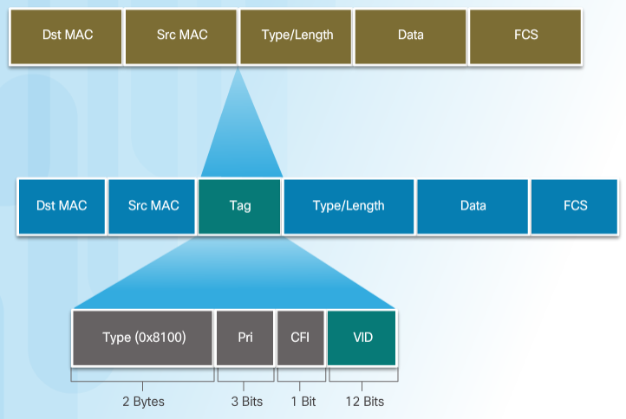
VLANs in a Multi-Switched Environment
Tagging Ethernet Frames for VLAN Identification
Catalyst 2960 Series switches are Layer 2 devices use the Ethernet frame header not routing tables.
Ethernet frame header does not contain information about the VLAN to which the frame belongs;
When Ethernet frames are placed on a trunk, information about the VLANs to which they belong must
be added. This process, called tagging, is accomplished by using the IEEE 802.1Q header, specified in the IEEE 802.1Q standard (dot1q).
802.1Q header includes a 4-byte tag inserted within the original Ethernet frame header, specifying the VLAN to which the frame belongs.
Switch receives a frame on a port configured in access mode and assigned a VLAN
Notes:
6.1 – VLAN Segmentation
6.1.2 – VLANs in a Multi-Switched Environment
6.1.2.3 - Tagging Ethernet Frames for VLAN Identification

Slide 16
VLANs in a Multi-Switched Environment
Tagging Ethernet Frames for VLAN Identification
Before a frame is forwarded across a trunk link, it must be tagged with its VLAN information.
  Frame tagging is the process of adding a VLAN identification header to the frame.
  It is used to properly transmit multiple VLAN frames through a trunk link.
IEEE 802.1Q is a vey popular VLAN trunking protocol that defines the structure of the tagging header added to the frame.
  Switches add VLAN tagging information after the Source MAC address field.
  The fields in the 802.1Q VLAN tag includes VLAN ID (VID).
  Trunk links add the tag information before sending the frame and then remove the tags before forwarding frames through non-trunk ports.
Notes:
6.1 – VLAN Segmentation
6.1.2 – VLANs in a Multi-Switched Environment
6.1.2.3 - Tagging Ethernet Frames for VLAN Identification

Slide 17
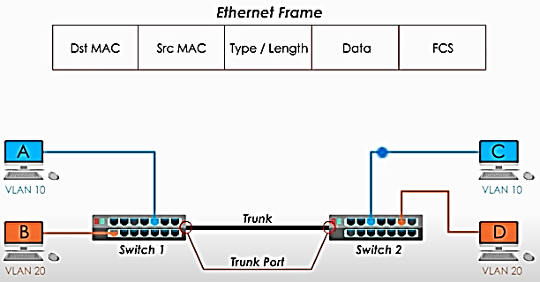
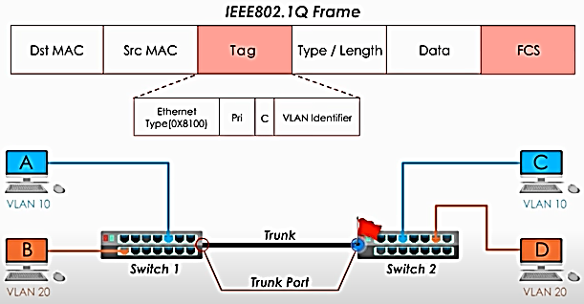
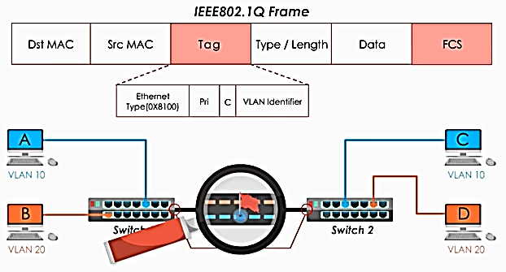
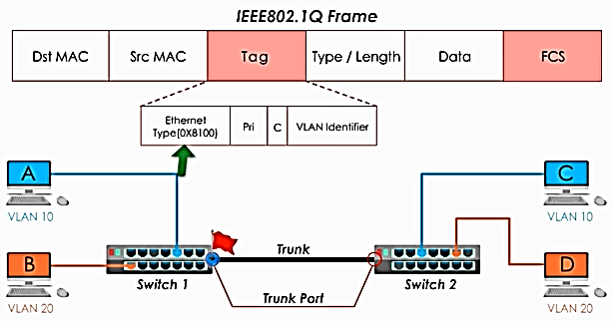
VLANs in a Multi-Switched Environment
Tagging Ethernet Frames for VLAN Identification
The process of adding VLAN tag into an Ethernet frame is called tagging.
The VLAN tag field consists of a Type field, a Priority field, a CFI field, and VID field:
Notes:
6.1 – VLAN Segmentation
6.1.2 – VLANs in a Multi-Switched Environment
6.1.2.3 - Tagging Ethernet Frames for VLAN Identification

Slide 18
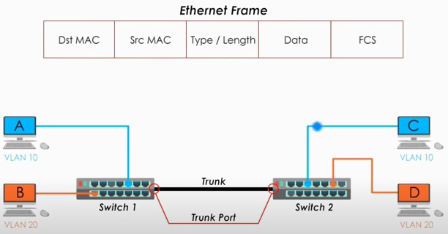
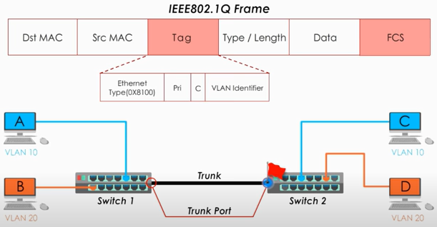
VLANs in a Multi-Switched Environment
Tagging Ethernet Frames for VLAN Identification
The process of adding VLAN tag into an Ethernet frame is called tagging.
The VLAN tag field consists of a Type field, a Priority field, a CFI field, and VID field:
Type—A 2-byte value called the tag protocol ID (TPID) value. For Ethernet, it is set to hexadecimal 0x8100. to recognize it is a frame to VLAN
User priority—A 3-bit value that supports level or service implementation. Use for QoS
Canonical Format Identifier (CFI)—A 1-bit identifier(set 0) that enables Token Ring frames to be carried across Ethernet links.
VLAN ID (VID)—A 12-bit VLAN identification number (1 to 4096 VLAN ID). Like tag VLAN ID is 10.
Notes:
6.1 – VLAN Segmentation
6.1.2 – VLANs in a Multi-Switched Environment
6.1.2.3 - Tagging Ethernet Frames for VLAN Identification

Slide 19
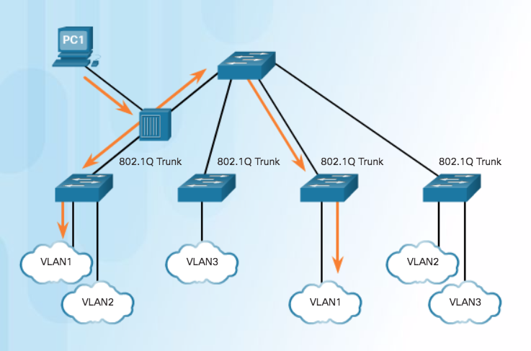
VLANs in a Multi-Switched Environment
Native VLANs and 802.1Q Tagging
Control traffic sent on the native VLAN should not be tagged.
Frames received untagged, remain untagged and are placed in the native VLAN when forwarded.
If there are no ports associated to the native VLAN and no other trunk links, an untagged frame is dropped.
When configuring a switch port on a Cisco switch, configure devices so that they do not send tagged frames on the native VLAN.
In Cisco switches, the native VLAN is VLAN 1, by default.
Notes:
6.1 – VLAN Segmentation
6.1.2 – VLANs in a Multi-Switched Environment
6.1.2.4 - Native VLANs and 802.1Q Tagging

Slide 20
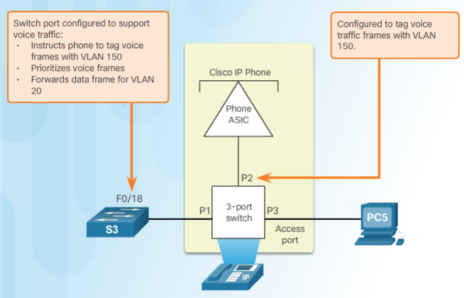
VLANs in a Multi-Switched Environment
Voice VLAN Tagging
An access port connecting a Cisco IP phone can be configured to use two separate VLANs:
  A VLAN for voice traffic
  A VLAN for data traffic from a device attached to the phone.
The link between the switch and the IP phone behaves like a trunk to carry traffic from both VLANs.
Cisco IP Phone contains an integrated three-port 10/100 switch dedicated to these devices:
  Port 1 connects to the switch or other VoIP device.
  Port 2 is an internal 10/100 interface that carries the IP phone traffic.
  Port 3 (access port) connects to a PC or other device.
Notes:
6.1 – VLAN Segmentation
6.1.2 – VLANs in a Multi-Switched Environment
6.1.2.5 - Voice VLAN Tagging

Slide 21
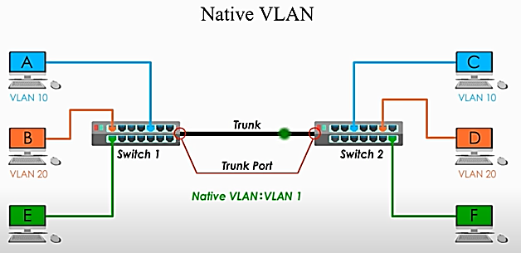
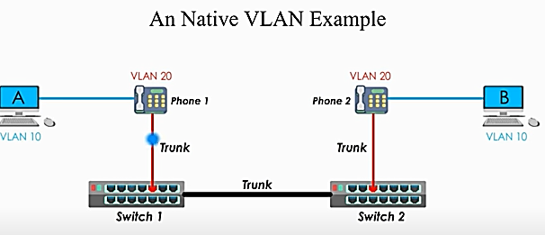
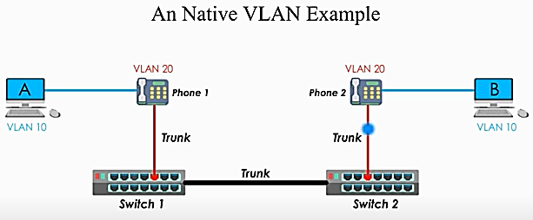
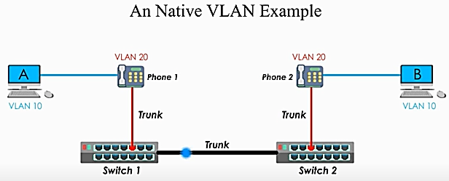
Native VLAN, Voice VLAN, Tagging
Pc E and Pc F not assign to any VLAN (default 1), Frame travel through trunk without VLAN tag. Better to use unused VLAN number like 99,666,777 (native VLAN with 1, allows attack)
Rather than use 4 separate line, connect IP phone(VALN 20) to switch and PC(VLAN 10) to IP phone(built-in-switch support 802.1q standard)
Pc(VLAN 10 configure native VLAN) send or receive untagged traffic and IP phone send or receive tagged traffic. Native useful when data and voice VLAN share one same link.
Notes:
6.1 – VLAN Segmentation
6.1.2 – VLANs in a Multi-Switched Environment
6.1.2.5 - Voice VLAN Tagging

Slide 22
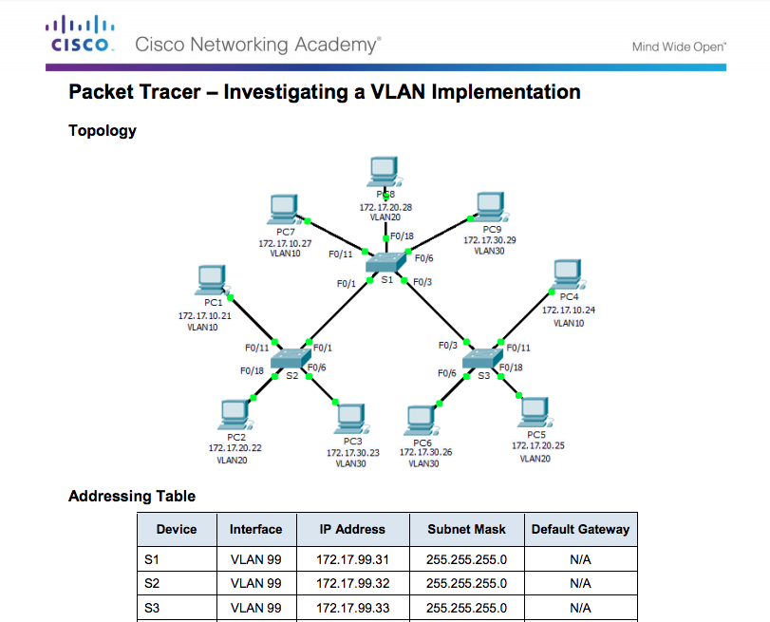
VLANs in a Multi-Switched Environment
Packet Tracer – Investigating a VLAN Implementation
Notes:
6.1 – VLAN Segmentation
6.1.2 – VLANs in a Multi-Switched Environment
6.1.2.7 – Packet Tracer – Investigating a VLAN Implementation

Slide 23
6.2 VLAN Implementation
Notes:
6 - VLANs
6.2 – VLAN Implementation

Slide 24
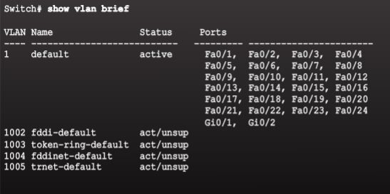
VLAN Assignment
VLAN Ranges on Catalyst Switches
VLANs are split into two categories:
  Normal range VLANs
    VLAN numbers from 1 to 1,005
    Configurations stored in the vlan.dat (in the flash memory)
    IDs 1002 through 1005 are reserved for legacy Token Ring and Fiber Distributed Data Interface (FDDI) VLANs, automatically created and cannot be removed.
Cisco Catalyst 2960 and 3560 Series switches support over 4,000 VLANs.
  Extended Range VLANs
    VLAN numbers from 1,006 to 4,096
    Configurations stored in the running configuration (NVRAM)
    VLAN Trunking Protocol (VTP) does not learn extended VLANs
Notes:
6.2 – VLAN Implementations
6.2.1 – VLAN Assignment
6.2.1.1 - VLAN Ranges on Catalyst Switches

Slide 25
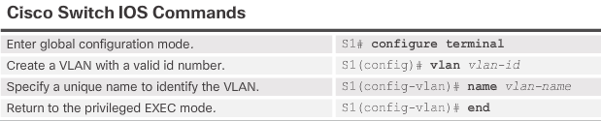
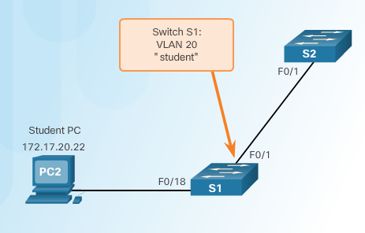

VLAN Assignment
Creating a VLAN
Notes:
6.2 – VLAN Implementations
6.2.1 – VLAN Assignment
6.2.1.2 – Creating a VLAN

Slide 26
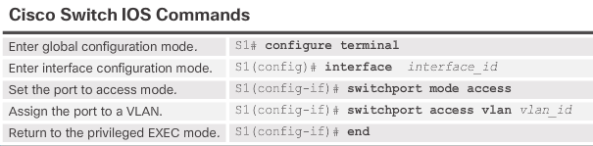
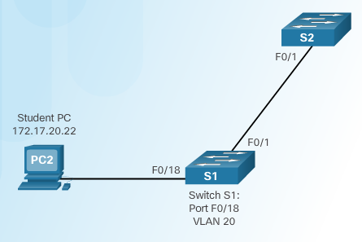
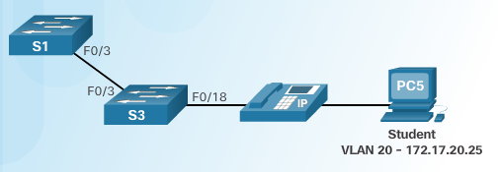
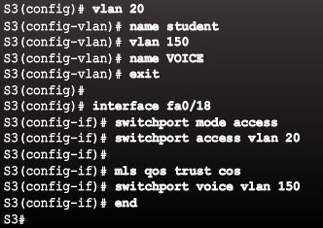

VLAN Assignment
Assigning Ports to VLANs
Example 1
Example 2
Notes:
6.2 – VLAN Implementations
6.2.1 – VLAN Assignment
6.2.1.3 – Assigning Ports to VLANs

Slide 27
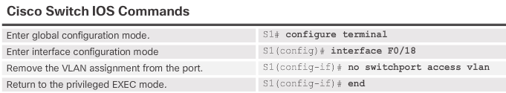
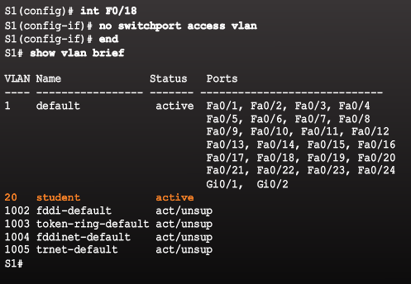
VLAN Assignment
Changing VLAN Port Membership
Remove VLAN Assignment
Even though interface F0/18 was previously assigned to VLAN 20, it reset to the default VLAN1.
Notes:
6.2 – VLAN Implementations
6.2.1 – VLAN Assignment
6.2.1.4 - Changing VLAN Port Membership

Slide 28
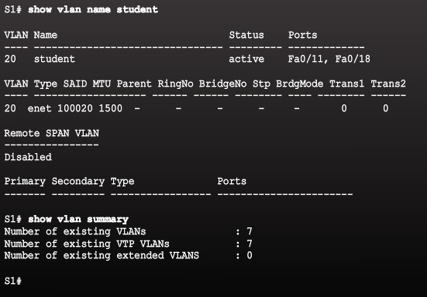
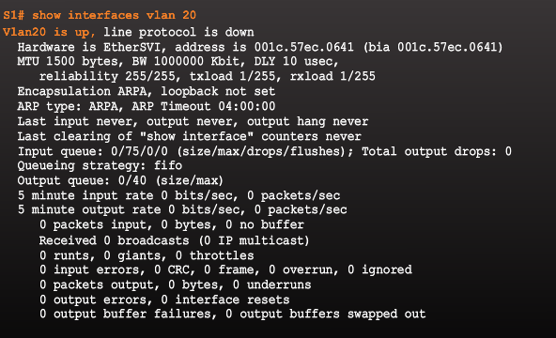
VLAN Assignment
Verifying VLAN Information
VLAN configurations can be validated using the Cisco IOS show vlan and show interfaces command options.
Notes:
6.2 – VLAN Implementations
6.2.1 – VLAN Assignment
6.2.1.6 - Verifying VLAN Information

Slide 29
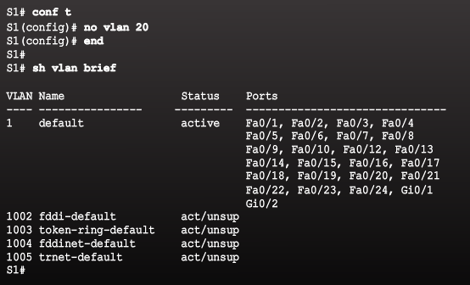
VLAN Assignment
Deleting VLANs
Use the no vlan vlan-id global configuration mode command to remove VLAN.
To delete the entire vlan.dat file, use the delete flash:vlan.dat privileged EXEC mode command.
  delete vlan.dat can be used if the vlan.dat file has not been moved from its default location.
Notes:
6.2 – VLAN Implementations
6.2.1 – VLAN Assignment
6.2.1.5 – Deleting VLANs

Slide 30
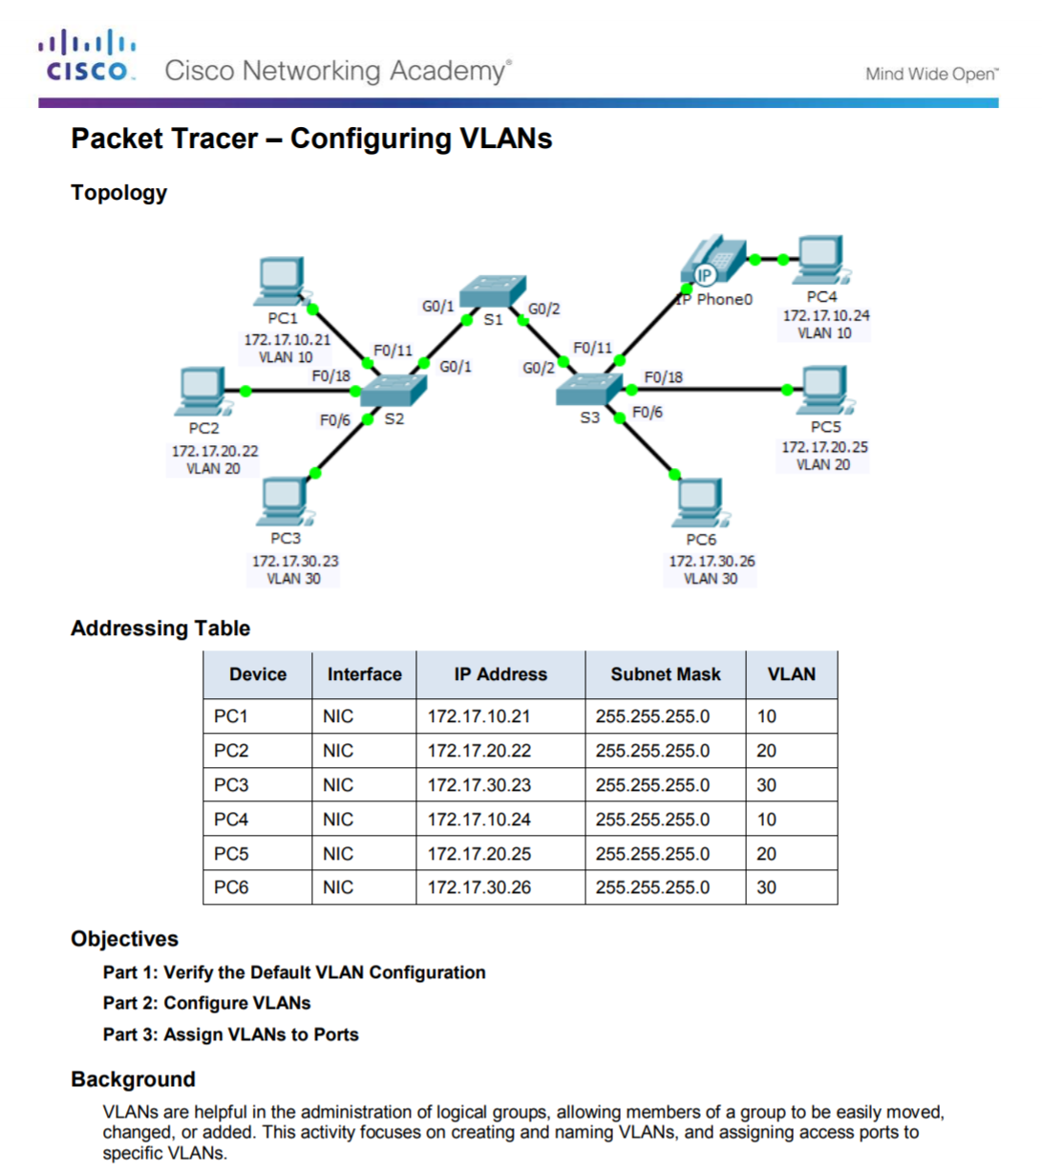
VLAN Assignment
Packet Tracer – Configuring VLANs
Notes:
6.2 – VLAN Implementations
6.2.1 – VLAN Assignment
6.2.1.7 – Packet Tracer – Configuring VLANs

Slide 31
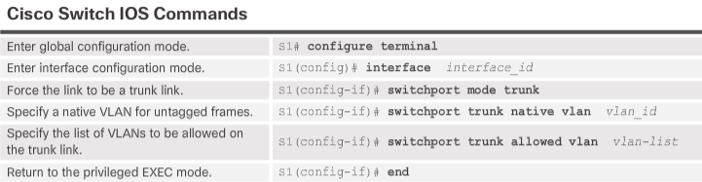
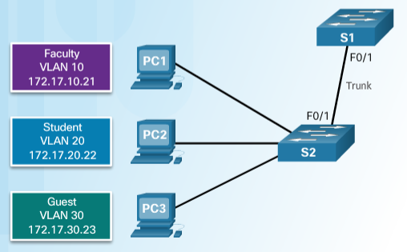
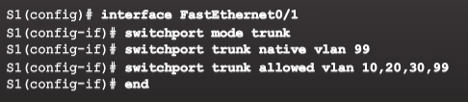
VLAN Trunks
Configuring IEEE 802.1q Trunk Links
Native VLAN
VLAN 99
172.17.99.0/24
Notes:
6.2 – VLAN Implementations
6.2.2 – VLAN Trunks
6.2.2.1 - Configuring IEEE 802.1q Trunk Links

Slide 32
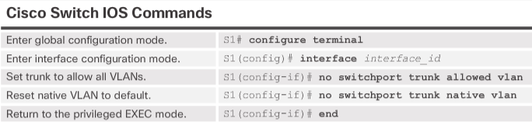
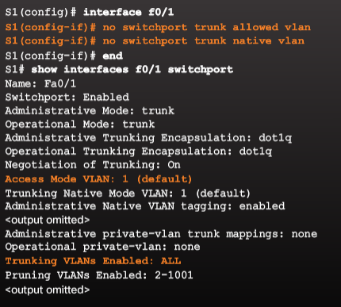
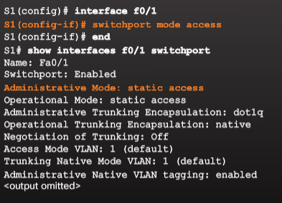
VLAN Trunks
Resetting the Trunk to Default State
F0/1 is configured as an access port which removes the trunk feature.
Notes:
6.2 – VLAN Implementations
6.2.2 – VLAN Trunks
6.2.2.2 - Resetting the Trunk to Default State

Slide 33

VLAN Trunks
Verifying Trunk Configuration
Notes:
6.2 – VLAN Implementations
6.2.2 – VLAN Trunk
6.2.2.3 - Verifying Trunk Configuration

Slide 34

VLAN Trunks
Packet Tracer – Configuring Trunks
Notes:
6.2 – VLAN Implementations
6.2.2 – VLAN Trunks
6.2.2.4 - Packet Tracer – Configuring Trunks

Slide 35

VLAN Trunks
Lab – Configuring VLANs and Trunks
Notes:
6.2 – VLAN Implementations
6.2.2 – VLAN Trunks
6.2.2.5 – Lab – Configuring VLANs and Trunks

Slide 36

Troubleshoot VLANs and Trunks
IP Addressing Issues with VLANs
Common practice to associate a VLAN with an IP network.
  Different IP networks must communicate through a router.
  All devices within a VLAN must be part of the same IP network to communicate.
In the figure, PC1 cannot communicate to the server because it has a wrong IP address configured.
Notes:
6.2 – VLAN Implementations
6.2.3 – Troubleshoot VLANs and Trunks
6.2.3.1 - IP Addressing Issues with VLANs

Slide 37


Troubleshoot VLANs and Trunks
Missing VLANs
If all the IP address mismatches have been solved, but the device still cannot connect, check if the VLAN exists in the switch.
If the VLAN to which the port belongs is deleted, the port becomes inactive and is unable to communicate with the rest of the network.
  It is not functional until the missing VLAN is created or the VLAN is removed from the port.
Notes:
6.2 – VLAN Implementations
6.2.3 – Troubleshoot VLANs and Trunks
6.2.3.2 - Missing VLANs

Slide 38


Troubleshoot VLANs and Trunks
Introduction to Troubleshooting Trunks
  In this example, the Native VLAN should be VLAN 99 however, the output of the command identifies VLAN 2 as the Native VLAN.
  To solve this problem, configure the same native VLAN on both sides.
Notes:
6.2 – VLAN Implementations
6.2.3 – Troubleshoot VLANs and Trunks
6.2.3.3 - Introduction to Troubleshooting Trunks

Slide 39

Troubleshoot VLANs and Trunks
Common Problems with Trunks
Trunking issues are usually associated with incorrect configurations.
The most common type of trunk configuration errors are:
When a trunk problem is suspected, it is recommended to troubleshoot in the order shown above.
Notes:
6.2 – VLAN Implementations
6.2.3 – Troubleshoot VLANs and Trunks
6.2.3.4 - Common Problems with Trunks

Slide 40




Troubleshoot VLANs and Trunks
Incorrect Port Mode
In this example, PC4 cannot reach the Web server.
  The trunk links on S1 and S3 are verified and reveal that the S3 trunk port has been configured as an access port.
  To resolve the issue, the S3 F03 port is configured as a trunk link.
Notes:
6.2 – VLAN Implementations
6.2.3 – Troubleshoot VLANs and Trunks
6.2.3.5 - Incorrect Port Mode

Slide 41



Troubleshoot VLANs and Trunks
Incorrect VLAN List
In this example, PC5 cannot reach the Student Email server.
  The output of the switchport trunk allowed vlan command reveals S1 is not allowing VLAN 20.
  To resolve the issue, the S1 F0/1 port is configured to allow VLANs 10, 20, and 99.
Notes:
6.2 – VLAN Implementations
6.2.3 – Troubleshoot VLANs and Trunks
6.2.3.6 - Incorrect VLAN List

Slide 42

Troubleshoot VLANs and Trunks
Packet Tracer - Troubleshooting a VLAN Implementation - Scenario 1
Notes:
6.2 – VLAN Implementations
6.2.3 – Troubleshoot VLANs and Trunks
6.2.3.7 - Packet Tracer - Troubleshooting a VLAN Implementation - Scenario 1

Slide 43

Troubleshoot VLANs and Trunks
Packet Tracer - Troubleshooting a VLAN Implementation - Scenario 2
Notes:
6.2 – VLAN Implementations
6.2.3 – Troubleshoot VLANs and Trunks
6.2.3.8 - Packet Tracer - Troubleshooting a VLAN Implementation - Scenario 2

Slide 44

Troubleshoot VLANs and Trunks
Lab - Troubleshooting VLAN Configurations
Notes:
6.2 – VLAN Implementations
6.2.3 – Troubleshoot VLANs and Trunks
6.2.3.9 – Lab - Troubleshooting VLAN Configurations

Slide 45
6.3 Inter-VLAN Routing Using Routers
Notes:
6 - VLANs
6.3 – Inter-VLAN Routing Using Routers

Slide 46

Inter-VLAN Routing Operation
What is Inter-VLAN Routing?
Layer 2 switches cannot forward traffic between VLANs without the assistance of a router.
Inter-VLAN routing is a process for forwarding network traffic from one VLAN to another, using a router.
There are three options for inter-VLAN routing:
  Legacy inter-VLAN routing
  Router-on-a-Stick
  Layer 3 switching using SVIs
Notes:
6.3 – Inter-VLAN Routing Using Routers
6.3.1 – Inter-VLAN Routing Operation
6.3.1.1 - What is Inter-VLAN Routing?

Slide 47

Inter-VLAN Routing Operation
Legacy Inter-VLAN Routing
In the past:
  Router interfaces were used to route between VLANs.
  Each VLAN was connected to a different physical router interface.
  Packets would arrive on the router through one interface, be routed and leave through another.
  Because the router interfaces were connected to VLANs and had IP addresses from that specific VLAN, routing between VLANs was achieved.
  Large networks with large number of VLANs required many router interfaces.
In this example, the router was configured with two separate physical interfaces to interact with the different VLANs and perform the routing.
Notes:
6.3 – Inter-VLAN Routing Using Routers
6.3.1 – Inter-VLAN Routing Operation
6.3.1.2 - Legacy Inter-VLAN Routing

Slide 48

Inter-VLAN Routing Operation
Router-on-a-Stick Inter-VLAN Routing
The router-on-a-stick approach uses only one of the router’s physical interface.
  One of the router’s physical interfaces is configured as a 802.1Q trunk port so it can understand VLAN tags.
  Logical subinterfaces are created; one subinterface per VLAN.
  Each subinterface is configured with an IP address from the VLAN it represents.
  VLAN members (hosts) are configured to use the subinterface address as a default gateway.
In this example, the R1 interface is configured as a trunk link and connects to the trunk F0/4 port on S1.
Router accepts VLAN-tagged traffic on the trunk interface
Router internally routes between the VLANs using subinterfaces.
Router then forwards the routed traffic as VLAN-tagged for the destination VLAN out the trunk link.
Notes:
6.3 – Inter-VLAN Routing Using Routers
6.3.1 – Inter-VLAN Routing Operation
6.3.1.3 - Router-on-a-Stick Inter-VLAN Routing

Slide 49

Configure Legacy Inter-VLAN Routing
Configure Legacy Inter-VLAN Routing: Preparation
Legacy inter-VLAN routing requires routers to have multiple physical interfaces.
Each one of the router’s physical interfaces is connected to a unique VLAN.
Each interface is also configured with an IP address for the subnet associated with the particular VLAN.
Network devices use the router as a gateway to access the devices connected to the other VLANs.
Notes:
6.3 – Inter-VLAN Routing Using Routers
6.3.2 – Configure Legacy Inter-VLAN Routing
6.3.2.1 - Configure Legacy Inter-VLAN Routing: Preparation

Slide 50


Configure Legacy Inter-VLAN Routing
Configure Legacy Inter-VLAN Routing: Switch Configuration
Configure the VLANs on the switch and then assign the ports to their respective VLANs.
In this example, the S1 ports are configured as follows:
  Ports F0/4 and F0/11 of S1 are on VLAN 10
  Ports F0/5 and F0/16 ports are on VLAN 30.
Notes:
6.3 – Inter-VLAN Routing Using Routers
6.3.2 – Configure Legacy Inter-VLAN Routing
6.3.2.2 - Configure Legacy Inter-VLAN Routing: Switch Configuration

Slide 51

Configure Legacy Inter-VLAN Routing
Configure Legacy Inter-VLAN Routing: Router Interface Configuration
Next configure the router interfaces.
Notes:
6.3 – Inter-VLAN Routing Using Routers
6.3.2 – Configure Legacy Inter-VLAN Routing
6.3.2.3 - Configure Legacy Inter-VLAN Routing: Router Interface Configuration

Slide 52

Configure Legacy Inter-VLAN Routing
Lab – Configuring Per-Interface Inter-VLAN Routing
Notes:
6.3 – Inter-VLAN Routing Using Routers
6.3.2 – Configure Legacy Inter-VLAN Routing
6.3.2.4 – Lab – Configuring Per-Interface Inter-VLAN Routing

Slide 53

Configure Router-on-a-Stick Inter-VLAN Routing
Configure Router-on-a Stick: Preparation
An alternative to legacy inter-VLAN routing is to use VLAN trunking and subinterfaces.
VLAN trunking allows a single physical router interface to route traffic for multiple VLANs.
The physical interface of the router must be connected to a trunk link on the adjacent switch.
On the router, subinterfaces are created for each unique VLAN.
Each subinterface is assigned an IP address specific to its subnet or VLAN and is also configured to tag frames for that VLAN.
Notes:
6.3 – Inter-VLAN Routing Using Routers
6.3.3 – Configure Router-on-a-Stick Inter-VLAN Routing
6.3.3.1 - Configure Router-on-a Stick: Preparation

Slide 54


Configure Router-on-a-Stick Inter-VLAN Routing
Configure Router-on-a Stick: Switch Configuration
To enable inter-VLAN routing using router-on-a stick, start by enabling trunking on the switch port that is connected to the router.
Notes:
6.3 – Inter-VLAN Routing Using Routers
6.3.3 – Configure Router-on-a-Stick Inter-VLAN Routing
6.3.3.2 - Configure Router-on-a Stick: Switch Configuration

Slide 55

Configure Router-on-a-Stick Inter-VLAN Routing
Configure Router-on-a Stick: Router Subinterface Configuration
The router-on-a-stick method requires subinterfaces to be configured for each routable VLAN.
  The subinterfaces must be configured to support VLANs using the encapsulation dot1Q VLAN-ID interface configuration command.
Notes:
6.3 – Inter-VLAN Routing Using Routers
6.3.3 – Configure Router-on-a-Stick Inter-VLAN Routing
6.3.3.3 - Configure Router-on-a Stick: Router Subinterface Configuration

Slide 56


Configure Router-on-a-Stick Inter-VLAN Routing
Configure Router-on-a Stick: Verifying Subinterfaces
By default, Cisco routers are configured to route traffic between local subinterfaces.
  As a result, routing does not specifically need to be enabled.
Use the show vlan and show ip route commands to verify the subinterface configurations.
The show vlan command displays information about the Cisco IOS VLAN subinterfaces.
The show ip route command displays the routing table containing the networks associated with outgoing subinterfaces.
Notes:
6.3 – Inter-VLAN Routing Using Routers
6.3.3 – Configure Router-on-a-Stick Inter-VLAN Routing
6.3.3.4 - Configure Router-on-a Stick: Verifying Subinterfaces

Slide 57



Configure Router-on-a-Stick Inter-VLAN Routing
Configure Router-on-a Stick: Verifying Routing
Remote VLAN device connectivity can be tested using the ping command.
  The command sends an ICMP echo request and when a host receives an ICMP echo request, it responds with an ICMP echo reply.
Tracert is a useful utility for confirming the routed path taken between two devices.
Notes:
6.3 – Inter-VLAN Routing Using Routers
6.3.3 – Configure Router-on-a-Stick Inter-VLAN Routing
6.3.3.5 - Configure Router-on-a Stick: Verifying Routing

Slide 58

Configure Router-on-a-Stick Inter-VLAN Routing
Packet Tracer - Configuring Router-on-a-Stick Inter-VLAN Routing
Notes:
6.3 – Inter-VLAN Routing Using Routers
6.3.3 – Configure Router-on-a-Stick Inter-VLAN Routing
6.3.3.6 -Packet Tracer - Configuring Router-on-a-Stick Inter-VLAN Routing

Slide 59

Configure Router-on-a-Stick Inter-VLAN Routing
Lab - Configuring 801.2Q Trunk-Based Inter-VLAN Routing
Notes:
6.3 – Inter-VLAN Routing Using Routers
6.3.3 – Configure Router-on-a-Stick Inter-VLAN Routing
6.3.3.7 -Lab - Configuring 801.2Q Trunk-Based Inter-VLAN Routing

Slide 60

Configure Router-on-a-Stick Inter-VLAN Routing
Packet Tracer - Inter-VLAN Routing Challenge
Notes:
6.3 – Inter-VLAN Routing Using Routers
6.3.3 – Configure Router-on-a-Stick Inter-VLAN Routing
6.3.3.8 -Packet Tracer - Inter-VLAN Routing Challenge

Slide 61
6.4 Chapter Summary
Notes:
6 - VLANs
6.4 – Summary

Slide 62

Conclusion
Packet Tracer - Skills Integration Challenge
Notes:
6.4 – Summary
6.4.1 – Conclusion
6.4.1.2 – Packet Tracer - Skills Integration Challenge

Slide 63
Conclusion
Chapter 6: VLANs
Explain how VLANs segment broadcast domains in a small to medium-sized business network.
Implement VLANs to segment a small to medium-sized business network..
Configure routing between VLANs in a small to medium-sized business network.
Notes:
6.4 – Summary
6.4.1 – Conclusion
6.4.1.3 – Chapter 6: VLANs

Slide 64
Section 6.1
New Terms and Commands
VLAN Logical broadcast domain Data VLAN Default VLAN Native VLAN Management VLAN show vlan brief Voice VLAN VLAN Trunk VLAN Segmentation IEEE 802.1Q VLAN Tagging Canonical Format Identifier (CFI) | User Priority VLAN ID Type show interfaces int switchport
Notes:
New Terms and Commands

Slide 65
Section 6.2
New Terms and Commands
Normal Range VLANs Extended Range VLANs vlan vlan-id name vlan-name switchport mode access switchport access vlan vlan-id interface range no switchport access vlan vlan-id no vlan vlan-id delete flash:vlan.dat delete vlan.dat | show vlan show interfaces show vlan summary show interfaces vlan vlan_id switchport mode trunk switchport trunk allowed vlan vlan_list switchport trunk native vlan vlan_id no switchport trunk allowed vlan no switchport trunk native vlan show interfaces switchport | no switchport access vlan vlan_id show interfaces trunk show interfaces int_id trunk
Notes:
New Terms and Commands

Slide 66
Section 6.3
New Terms and Commands
Legacy Inter-VLAN Routing Router-on-a-Stick Inter-VLAN Routing interface interface_id.subinterface_id encapsulation dot1q vlan_id IEEE 802.1Q
Notes:
New Terms and Commands

